Slide 1
OCR Error Detection
MMNet
Ray

Slide 2
Problem Statement
What is the problem?
Though current OCR technology is quite refined and robust, sources such as old books, poor-quality photocopies, and faxes can still be difficult to process and may cause many OCR errors.
One of the most important topic for OCR is the OCR error detection, and our goal is to present an efficient and high accuracy OCR error detecting system.

Slide 3
Traditional Error Detecting System
In tradition, the error detecting system only allowed the user to detect words one by one, and the words are presented in an irregular way.
Defect:
Time consuming => bad efficiency
Tiresome => bad concentration => bad accuracy

Slide 4
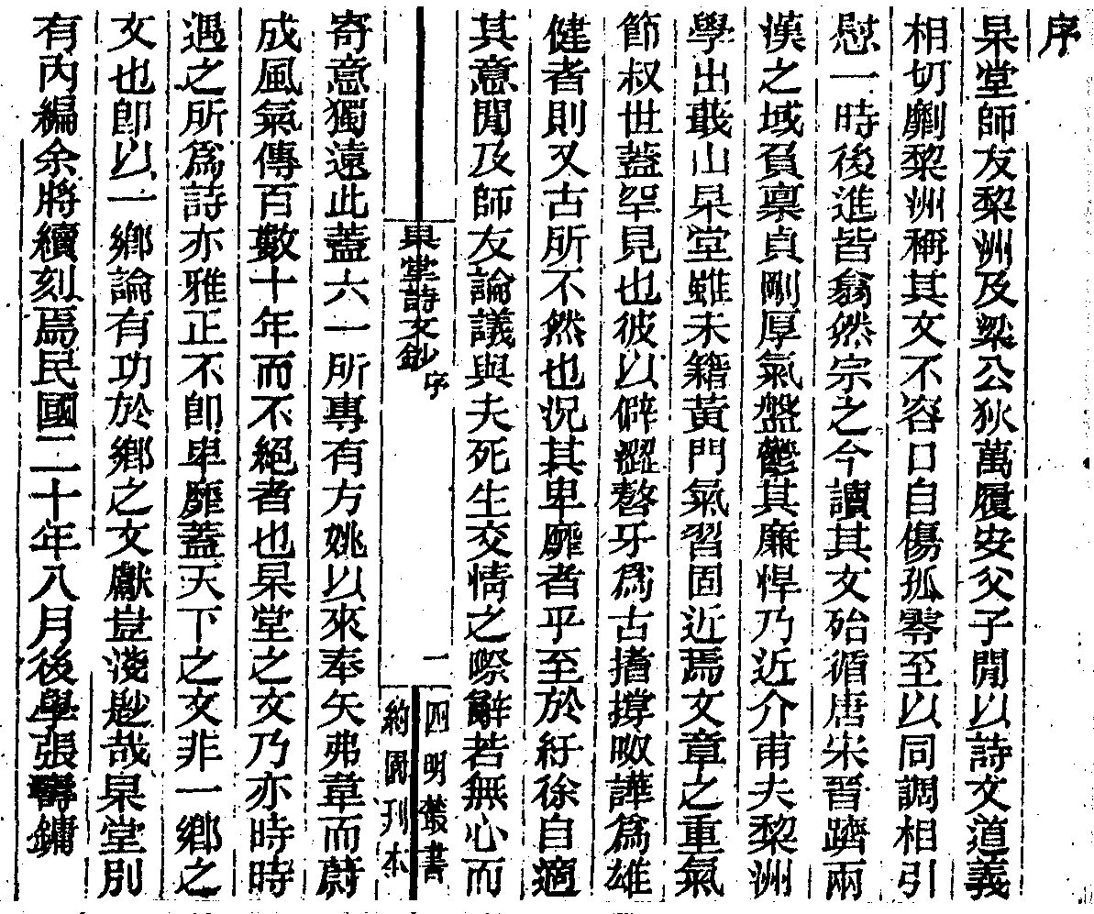
Traditional Error Detecting System
Recognized Result
Source
序
杲堂師友棃洲及梁公狄萬履安父子閒以詩文道義
相切劘棃洲稱其文不容口自傷孤零至以同調相引
慰一時後進皆翕然宗之今讀其文殆循唐宋晉躋兩
漢之域負稟貞剛厚氣盤鬱其廉悍乃近介甫夫棃洲
學出蕺山杲堂雖未籍黃門氣習固近焉文章之重氣
節叔世蓋罕見也彼以僻澀嗸牙為古搘撐呶譁為雄
健者則又古所不然也況其卑靡者乎至於紆徐自適
其意閒及師友論議與夫死生交情之際辭若無心而
寄意獨遠此蓋六一所專有方姚以來奉矢弗韋而蔚
成風氣傳百數十年而不絕者也杲堂之文乃亦時時
遇之所為詩亦雅正不即卑靡蓋天下之文非一鄉之
文也卽以一鄉論有功於鄉之文獻豈淺尟哉杲堂別
有內編余將續刻焉民國二十年八月後學張壽鏞

Slide 5
Our OCR Error Detecting System
1. Present sequentially
Show the word images one at a time, as the user notice an error, inform the error detecting system that this word image is not recognized correctly.
2. Present in grid view
Show the word images in grid view, as the user notice an error, inform the error detecting system that this word image is not recognized correctly.

Slide 6
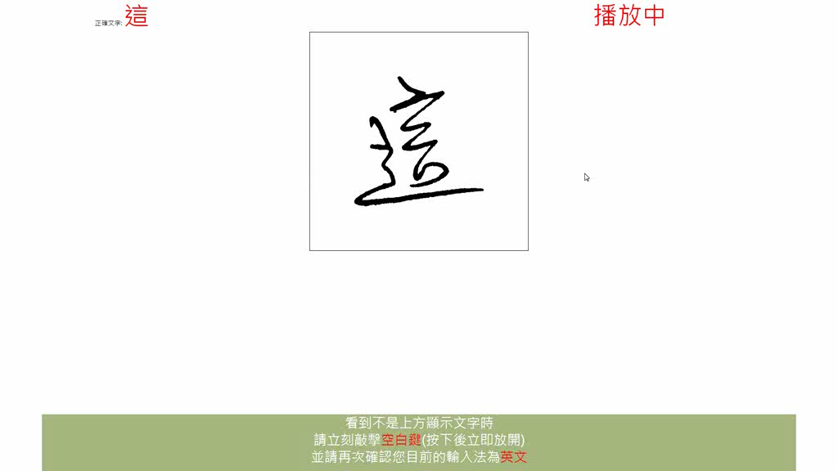
Sequential Error Detecting System

Slide 7
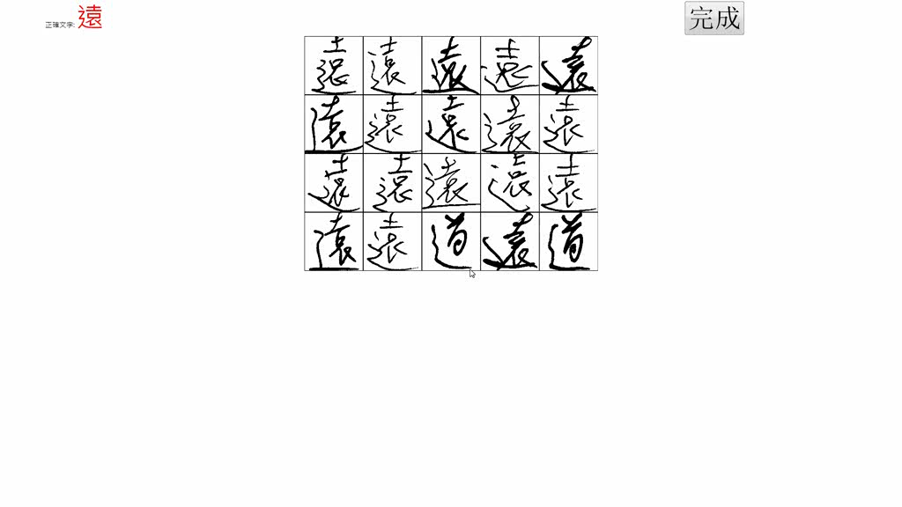
Grid Error Detecting System

Slide 8
Gather Data
Crowdsourcing
By presenting online experiments, we can gather data from different kinds of people, varying from age, occupation, gender, etc.

Slide 9
Experiment Site
1. Present sequentially
http://mmnet.iis.sinica.edu.tw/~ray/ocr_seq/index.php
2. Present in grid view
http://mmnet.iis.sinica.edu.tw/~ray/ocr_grid/index.php

